Slide 1
My ppt presentations:Raven Mottus Prague 1-21-20 EXTENDED.pptx
This is an extended version spelling out things normally covered ad lib
The original still exists in Non RPM conference papers with a .PDF extension
And should be used in lectures.
To avoid over-writing it in EOS I have re-named it
Raven Mottus Prague 1-21-20 original PPT PDF.PDF
This is NOT the version which currently appears on EOS
The one on EOS does NOT contain the detail on schools.
But BOTH contain a grid which has been extended to include more components of competence but not more potentially valued activities.
Recent Research Supporting a Specific-motive-based Model of Competence
(Extended version).
John Raven
Version date: 3 December 2021

Slide 2
Prologue
Every normal man, woman, and child is … a genius at something … It remains to discover at what … This must be a most difficult matter, owing to the very fact that it occurs in only a minute proportion of all possible abilities. It certainly cannot be detected by any of the testing procedures at present in current usage. But these procedures are capable, I believe, of vast improvement. (Spearman, 1924)

Slide 3
Recent Research Supporting a Specific-motive-based Model of Competence

Slide 4
Background

Slide 5
Precipitated by chance attendance at a seminar led by Rene Mottus

Slide 6
His team had accidentally discovered that much better predictions of changes in “personality” with age could be made from individual items extracted from Big 5 questionnaires than from either factor scores or carefully selected clusters of items deemed to measure “facets” of personality.

Slide 7
Here are some of the results

Slide 9
And here are some of the conclusions drawn

Slide 10
First, the Big Five domain scores excluded over half of the age-sensitive information available in the data.
While the accuracy of the Big Five-based predictions averaged at r = .28
the 30-facet-based predictions had an average of r = .44
and the 300 item-based predictions achieved more than two times higher correlations with age with average r = .65

Slide 11
But the fourth finding was the most dramatic:
Individuals at different ages differed in specific behavioural, cognitive, affective and motivational patterns indexed by individual items, not because they differed in the domains and facets per se but because they differed in something that the items uniquely reflected – that is, nuances.

Slide 12
Clearly, we will need an empirically based and comprehensive taxonomy of nuances and tools for measuring them if we are to tap into this currently almost hidden, but vast, personality variance, be it for predicting outcomes, studying personality development, or other purposes.

Slide 13
One way forward would be to restart the kinds of taxonomic research programs that led to the Big Five.
This could either based on the lexical approach or start from unstructured item pools, not with the goal to identify the few major but the many dimensions of personality.

Slide 14
Historically, the goal has been parsimony, achieved by aggregating and filtering out as much information as possible.
For the development of a taxonomy of nuances, however, the goal should be capturing as much of individual differences in personality traits as is possible with measurement tools that are still usable.

Slide 15
Among other possibilities, we think that this can be achieved by creating measurement instruments that explicitly focus on the psychometric quality of single items such as their unambiguity and construct-relevance, retest reliability, cross-rater agreement, and low evaluativeness, while also avoiding wasteful redundancy among items.

Slide 16
(Note that) the test-retest reliability of many items is in the .70s (although it is considerably lower for many others).
Reasonably high reliability is thus achievable for even single items.

Slide 17
Explicitly relying on only high-quality items will allow measuring more traits with fewer items.
We imagine that it would be possible to measure at least 100 nuances with, say, 200 or 300 good-quality items.

Slide 18
Of course, I am delighted with these conclusions because they support my thesis.

Slide 19
But I feel I must draw attention to the sample on which the results are based – mainly because I believe that wider consideration of such things would have major implications for the interpretation of the mountains of studies which have relied on “Big Five” questionnaires.

Slide 20
Mottus’s studies were based on a “sample” of 24,000 drawn from a huge data set available to the research community.
But these participants had completed their questionnaires on the internet…

Slide 21
So: Question 1:
Who, actually, are these people?
Next, the sample had a mean age of 25 and a SD of 10.

Slide 22
This brings me to Question 2:
Who, exactly, are the 50 year olds who have been studied?
Certainly they must differ from the younger groups in other ways besides age (they are outliers in the age distribution).

Slide 23
But note this in passing:
How legitimate is it to report and talk about “Standard Deviations” in such a skewed population?
Notes:
And how do we know it is skewed?

Slide 24
These are not minor issues.
Neglect of such issues, to which the APA Task Force on Statistical Inference would have drawn attention had its final report ever been published, lie behind the “replication crisis”.

Slide 25
Worse, they lie behind the vast mountains of misleading publications which fill our our journals.

Slide 26
I have been made acutely aware of these problems as a result of my work with the RPM where I encountered thousands of DRIP (Data Rich, Information Poor) and DPIP (Data Poor Information Poor) studies based on tiny and unrepresentative “samples” and inappropriate applications of factor analysis and “sophisticated” IRT programs.

Slide 27
Because the RPM has directly affected the lives of billions of people worldwide, these studies were not without huge social significance.

Slide 28
It has not been my interest to study these things in relation to the Big Five, but I did stumble across some indications of the importance of doing so some 60 years ago.

Slide 29
I was studying people’s housing preferences and had the idea that these might be related to their personality as assessed by the 16PF.
So I found myself trying to administer the 16PF to a dustman.
There were questions like “Would you rather go to a lively party or work on a boring assignment?”
Not surprisingly, the dustman (and others) responded with blank incomprehension.

Slide 30
I concluded that either Cattell had not administered his test to a cross section of the population or his interviewers had, as is standard practice if asked what a question means, been told to say that they did not know but the respondent should answer as they thought best.
(I have encountered exactly the same response when I have asked what questions I have been asked in recent surveys actually mean.)

Slide 31
Puzzled by this, I went to see Peter Saville who was then a young researcher working on the 16PF at the NFER.
“Ah”, said Peter, “we have recently administered the test to a sample of the general population, and the only group for which we get a meaningful factor structure – any structure at all, never mind Cattell’s 16 factors – is among educated urban males”.

Slide 32
That confirmed my suspicions and, over years, my grounds for suspicion have been reinforced.
In the course of our work with the RPM we acquired something of a reputation for knowing something about psychological measurement – including factor analysis.
Accordingly, several researchers wrote to us saying that they had been working with the 16PF but had not obtained the 16 factor structure.

Slide 33
When they had written to Cattell about this, he had responded “send the data to me”.
When they did this, back came the 16 factor structure.
The trick was, of course, performed by inserting “marker variables”.

Slide 34
OK
So much for my suspicions about the factor structure of the Big 5 and related questionnairs.

Slide 35
But now to go back to Mottus.
Those who attended the small seminar I mentioned then set about seeking possible explanations for the results.
These included…

Slide 36
The fact that factor analysis of Likert-type items yields what are, in effect, arbitrary metrics (in that the same score can be achieved in many different ways – i.e. a given score can, in reality, mean very different things). [In this sense they differ from measures which conform to the requirements of Item Response Theory]

Slide 37
The number and location of the vectors extracted as a basis on which to reproduce a large covariance matrix from a smaller number of “underlying” variables is also at the discretion of the investigator (and is, in this sense too, also arbitrary.)

Slide 38
But the discussion also veered off into:
The possibility of finding genome specifications for the hundred or so “traits” that might be envisaged.

Slide 39
The possibility of capitalising on the fact that people seem to have a predisposition to select themselves into environments which enhance their genetic predispositions.

Slide 40
The possibility of finding additional items by extending the coverage of the questionnaires.

Slide 41
At this point I started to say that there existed a perhaps a more parsimonious/elegant framework for handling the observations, problems, and possibilities that had been mentioned …
as well as highlighting the areas in which it might be fruitful to pursue developments …
and offered a two minute outline … to which I shall return here.

Slide 42
But the next development was even more unanticipated and exciting.
After the seminar I contacted a mutual colleague and asked her what she thought of Rene’s work.

Slide 43
This produced a remarkable collection of articles, all of which are cited in the reading list.

Slide 44
I don’t want to get stuck here but a couple of them dealt with the coverage issue that had been raised.
One was a remarkable paper by Tom Bouchard (2016).

Slide 45
Bouchard hugely expanded the nature and type of the item pool by including items derived from numerous other tests - such as the Strong Vocational Interest Blank and the Allport-Vernon Study of Values.

Slide 46
Factor analysis of the resulting matrix yielded 12 factors which could be collapsed to 4.
These are substantially different from those conventionally extracted by those who favour the Big Five.

Slide 47
Realistic, Helping, Analytical, Aggressive, Pathology, Affiliative, Sensation-seeking, Traditional, Self-reliant, Cultured, Persuasive, Entrepreneurial
Dangerous, Authoritarian, Powerful, Down-to-Earth

Slide 49
But even more important from my point of view among the collection of papers were:
Hayes, published in 1962, entitled Genes, Drives, and Intellect.
Other aspects of Bouchard’s (2016) Experience Producing Drive Theory: Personality “Writ Large”.
Bouchard, et al., 1996, entitled EPD Theory Revised.
And a paper by Johnson, (2010) entitled Extending and testing Tom Bouchard’s Experience Producing Drive Theory.
Notes:
This may be the paper by Bouchard already mentioned previously

Slide 50
In his conclusions to his long paper Hayes writes:
“Innate intellectual potential (appears to consist) of (motivational dispositions) to engage in activities conducive to learning, rather than inherited intellectual capacities, as such. These tendencies (may be) referred to as experience-producing drives (EPDs)” (p. 337).
Notes:
innate intellectual potential consists of tendencies to engage in activities conducive to learning, rather than inherited intellectual capacities, as such. These tendencies are referred to here as exferience-prodwingdrives (EPDs) .

Slide 51
He continues:
“The following conclusions appear to be warranted: (1) Although it has been customary to assume that activity preferences are determined by experience, there is ample evidence to show that such preferences may be genetically controlled.
(2) Genetically controlled tendencies to engage in specific kinds of activity lead to the acquisition of corresponding skills and information.”

Slide 52
In saying these things he appears to have anticipated the process, later noted by Scarr (1983), whereby people with particular motivational dispositions select themselves into environments which cyclically enhance those dispositions.

Slide 53
I find the phrase Experience Producing Drives confusing and prefer to settle for saying that people with particular motivational dispositions tend to select themselves into environments which cyclically enhance those dispositions.

Slide 54
These papers were of particular interest to me because of the work we had done on the nature of developmental environments in homes, schools, and workplaces.

Slide 55
Expressed in terms that were not available to us at the time, these parents, teachers, and managers
created environments in which people could pursue their idiosyncratic motivational dispositions and, in the process, hone the components of competence needed to pursue them effectively.

Slide 56
We were alerted to look for this process among parents by one of the Educational Home Visitors involved in an educational home visiting programme we had been asked to evaluate.

Slide 57
The programme involved trained teachers, who were also parents, vising the homes of 2-3 year old children in order to interact with the children in the mothers’ presence.
The aim was to model the mothering process that were likely to enhance the children’s cognitive development.

Slide 58
In the course of the evaluation we had regular meetings with the EHVs.
At one point we had given transcripts of some of their visits to the Home Visitors.
One of them came to the next meeting in a clearly distressed state.
Asked “Why”? she responded by saying that, while she was supposed to be modelling parenting behaviour, “there I was being a teacher and not doing all sorts of things I would have done as a mother”.

Slide 59
Further discussion revealed that, among other things, she felt that there she was asking closed questions instead of following the child’s interests.
She could not behave “naturally” because she did not know the child, what his or her interests were, or the meaning of gestures.

Slide 60
Further evidence of the need for an individualised developmental framework came from an evaluation of environmentally based project work in primary schools.

Slide 61
The following account relates to a mixed-age, mixed-ability, class of 8 to 11 year old children.

Slide 62
In a lecture situation
ad lib About Laneton and skip next slides.
But don’t forget to mention
Emergent competencies dependent on emergent context and
emergent climates of enterprise able to harness multiple competencies to get things done.

Slide 63
At the time we studied them, the pupils’ project involved trying to do something about the pollution in the local river.

Slide 64
Some pupils decided that the first thing to do was to measure the pollution in the river.
They set about collecting samples of the river water and trying to analyse it.
They could not find the information they needed in the books they had available.
This took them to the not-so-local university where they worked with lecturers trying to engage with this – apparently difficult – problem.

Slide 65
Note that these pupils were developing the competencies of the scientist:
the ability to identify problems,
the ability to invent ways of investigating them,
the ability to obtain help,
the ability to familiarise themselves with a new field,
and
the ability to find ways of summarising information.
… rather than the ability to recite out of date information from textbooks.

Slide 66
Other pupils decided that more progress was to be made by studying the dead fish and plants along the river bank.
Still others argued that all this was beside the point: The river was clearly polluted: the problem was to get something done about it.
Some then set about drawing pictures of dead fish and plants from the river bank with a view to releasing community action.
The objective was not to depict what was seen accurately, but to represent it in such a way as to evoke emotions that would lead to action.

Slide 67
Note the implications for “Language”/writing ability
While the “scientists” mentioned above sought to report the results of their work in what might be termed a classic academic format, other pupils again argued that that was irrelevant and set about generating slogans, prose, and poetry that would evoke emotions that would lead to outrage and action.
In either case the criteria for what constituted effective reading and writing differed markedly from those which dominate most classrooms and they varied from pupil to pupil.

Slide 68
Still other pupils argued that, if anything was to be done about the river, it was necessary to get the environmental standards officer to do his job. (It turned out that he knew all about the pollution but had done nothing about it.)
This led some pupils to set up domino-like chains to influence politicians and public servants.
This in turn led the factory that was causing the problem to get at the pupils’ parents saying that, unless this teacher and her class was stopped, they would all lose their jobs.
Unabashed, some pupils set about examining the economic basis for the factory’s claims.

Slide 69
Note that this teacher was not so much concerned with enhancing pupils’ specialist knowledge in each of these areas as to nurture a wide range of different competencies in her pupils.

Slide 70
These competencies were not limited to substantive areas of investigation but also included the ability to contribute to group processes, including such things as:
the ability to put people at ease,
the ability to de-fuse the intolerance which develops between people who contribute in very different ways to a group process (e.g., the intolerance of “artists” for “scientists”),
the ability to publicise the observations of the quiet “ideas person”,
and the ability to “sell” the benefits of the unusual educational process to parents.

Slide 71
The teacher in fact devoted considerable attention to highlighting the different types of contribution which different children were making to the group process.
As a result, they stopped thinking of each other in terms of “smart vs. dumb” and instead noted what each was good at.

Slide 72
Note the “measurement” model implied here.
The words I have used imply, as a background, some kind of descriptive framework of the kind used in biology.
Pupils are not being rated on “scales”.
More specifically, the pupils are not being graded on a scale running from “high” to “low” “ability”.
All pupils are good at something; the question is: “What?”

Slide 73
So here we have the development of a wide variety of high-level competencies the “existence” of each of which depends on tapping each individual’s motives and creating situations in which they are able to develop and display their idiosyncratic talents and patterns of competence.

Slide 74
But that is not all.
Without the context of others engaged in related tasks they could not have developed these competencies.
Indeed many of those talents could only exist in those contexts.
Outwith that context those concerned could not even be said to possess them.
They were emergent competencies.

Slide 75
Not only that, the class as a whole displayed an emergent property which might be described as “collective intelligence” or “a climate of enterprise”.
Note that this emergent competence of the group, qua group, did not exist in anyone’s head. Indeed it did not “exist” anywhere.
It was a systems property.
Yet it was a real emergent property just as the properties of copper sulphate are distinct from the properties of copper, sulphur, and oxygen.

Slide 76
Nevertheless, it was produced by, and reciprocally affected, the emergent individual competencies of the pupils in the group.

Slide 77
But now let us look at what the teacher is doing:
i.e. let us look at the nature of her competence.

Slide 78
Just as the educational process for pupils largely took place in the environment outside the school so, too, did the work of the teacher.

Slide 79
Among other things
She spent a great deal of time with the parents of the children in order to legitimise the educational process she was implementing.
She spent time with school administrators and the heads of secondary schools undermining their faith in traditional tests as meaningful measures of such things as reading and mathematical ability … and assuring them that the futures of these children in their schools and the schools themselves (via “performance-based” assessments) were not being jeopardised as a result of the activities in which they were engaged.

Slide 80
These components of competence deployed by these teachers as managers of pupil development can be captured in the figure below, which was developed by Lees (1996) as a basis for discussing managerial competence in other organisations.

Slide 81
Political
Legal
Strategy
Structure
Culture
Rewards
Selection
Performance
Appraisal
Development
Human Resource Cycle
Technology
Economic
Socio-Cultural

Slide 82
What it shows is that:
Effective teachers, and managers more generally, have first to develop a very different, if largely unverbalised, image of the varieties of human talent and their development from the conventional human resource management view sketched in the central box.

Slide 83
They have to think about the individual motives and talents of each of their pupils or subordinates and create situations in which those pupils or subordinates can work together to develop those talents on an individual and collective basis.
They have to abandon conventional notions of selection and reward.
They have to think about the emergent properties of groups.

Slide 84
These things cannot be done for them by anyone else (such as HR specialists).
It is an integral component of their job.

Slide 85
What about competence in the workplace more generally?

Slide 86
My first study grew out of a survey of pupils, parents, teachers, and employers perceptions of the objectives of education.
This had shown that their top priorities included the development of such qualities as self-confidence, initiative, problem solving ability, ability to work with others and so on.

Slide 87
So the next question was:
Are such qualities actually of value, particularly in the workplace?

Slide 88
I set out to check this by going round the country interviewing a very wide range of people ranging from small farmers and blacksmiths through hotel owners and CEOs of trans-national companies to heads of government Departments.

Slide 89
I would begin by asking them to “Tell me something about your job and your life” and following up with further questions especially when they got excited about some problem they had.

Slide 90
The results not only confirmed the pupils’, parents’, teachers’, employers’ opinions but yielded important insights into the nature of competence.

Slide 91
My own study was followed by a review of some more systematic studies of competence in the workplace.
By the time I reviewed them there were about 80 of these.
And 300 or so by the time Lyle Spencer produced Competence at Work.

Slide 92
These studies relied on
Critical Incident Methodology

Slide 93
In critical incident methodology one first asks people to think of real occasions in which they have seen people – managers, machine operatives, mothers – performing particularly well.

Slide 94
On then asks them to describe what those people did, how others reacted, how did they respond to those reactions, etc.

Slide 95
One then transcribes these to index cards, and then sorts the cards into piles such that those in one pile have something in common but differ from those in other piles.
And then one seeks to identify what is common to the incidents in each pile.

Slide 96
Note that this is very different from relying on some external criterion like making a profit or conforming to a rule as the criterion of competence.

Slide 97
One then repeats the operation in relation to ineffective behaviours.

Slide 98
Here are the results from a study of managers (actually Naval officers)
Klemp Munger & Spencer
(next 2 slides):

Slide 99
Here are the are the behaviours More Effective Officers were said to engage in. (Klemp)
Initiative: Initiates new activities, communications, proposals; Exhibits resourcefulness, persistence in the face of obstacles.
Set goals and reconsiders and redefines them.
Coaches, by setting example and sharing information and thought processes.
Influences by persuasion, mustering arguments, building political coalitions, making others feel strong.
Conceptualises, analyses, and finds new ways of thinking about things.
Builds teams, acts to promote co-operation and team work.
Provides feedback to enable others to monitor their own performance. Helps them analyse problems and develop strategies for tackling them.
Provides rewards and official recognition for contributions.
Notes:
Competencies of More Effective Officers (Klemp)
Initiative: Initiates new activities, communications, proposals; Exhibits resourcefulness, persistence in the face of obstacles.
Set goals and reconsiders and redefines them.
Coaches, by setting example and sharing information and thought processes.
Influences: by persuasion, mustering arguments, building political coalitions, making others feel strong.
Conceptualises, analyses, and finds new ways of thinking about things.
Builds teams, acts to promote co-operation and team work.
Provides feedback to enable others to monitor their own performance. Helps them analyse problems and develop strategies for tackling them.
Provides rewards and official recognition for contributions.
cont.

Slide 100
Competencies of More Effective Officers (Klemp) cont.
Controls impulses, especially annoyance. avoids snap decisions based on incomplete evidence.
Plans and organises, including "domain planning".
Delegates.
Optimises: Analyses the capacity of individuals and resources and requirements of job, matches the two and fully utilises the resources available.
Monitors own behaviour and that of others.
Resolves conflicts.
Listens actively and initiates opportunities to give others a chance to talk.
Accurate empathy: Makes explicit unexpressed thoughts and feelings of others.
Helps.
Positive expectations of others' competence.

Slide 101
And here is another, somewhat surprising, illustration of the importance of high level self-motivated competencies in the workplace.

Slide 102
Qualities which critically distinguished more and less effective machine operators (Flanagan and Burns).
Dependability
Accuracy of reporting
Tendency to respond to the needs of the situation without having to be given instructions
Ability to get on with others
Initiative
Responsibility

Slide 103
And here is another interesting study.

Slide 104
Price, Taylor et al., Doctors
25 different types of excellent doctor ... different types of patient care, ability to work with and through nurses, contributions to medical organisations, academic output, contributions to non-medical organisations.
None were positively correlated with assessments made when those concerned were students.
Patients wanted very different kinds of doctor. LSES patients particularly wanted their doctors to be decisive and authoritative; HSES wanted attention to emotional and psychosomatic disorders and to discuss treatment.

Slide 105
Summary of What Said About Competence
Competence unexpectedly depends on:
Value-laden motivational dispositions like initiative and the ability to influence.
Perceptions of society and one’s role in it.
Understandings of terms like:
Participation
Wealth Creation
Management
Democracy
Emergent properties of groups that depend on a wide variety of people contributing in very different ways.

Slide 106
At this point I think it is important to highlight something which distinguishes these studies … and our studies of competence in homes, schools, and workplaces … from most other studies in the area.

Slide 107
Instead of looking for tests that would predict some externally determined criterion such as “academic” performance or profitability we were seeking to identify what people were good at.

Slide 108
The problem was that there was a lack of an appropriate conceptual framework for thinking about and discussing these things …
But, actually there was and is…
And it is to this that I will now turn.

Slide 109
But before doing so, I must mention one more reason for moving toward a specific motive based paradigm rather than scores on a scale:
The evaluation of psychotherapy.

Slide 110
Kazdin has shown that, in the course of psychotherapy, people change in all sorts of different directions and that different aspects of thought and behaviour within the individual change in different directions.
These changes cannot be captured in any group based study deploying off-the-shelf “measures”.

Slide 111
The alternative framework for thinking about individual differences that I would like to talk about derives from the work of David McClelland and his colleagues. Unfortunately that work is generally thought to have been discredited because the the measures do not have the properties that those who are steeped in factor-analysis and Item Response Theory look for.

Slide 112
It stemmed from Murray’s book Explorations in Personality, but the measures first got reconceptualised as:
Measures of “Motivation” and, later, “Competence”.

Slide 113
Indeed the very word competence was introduced to distinguish the work from the dominant HR industry concerned with identifying the “knowledge, skills, and attitudes” framework "required" for “high level” performance at a predefined job. Unfortunately the word “competence” has been hijacked and corrupted back to refer to just that.

Slide 114
The framework and measurement procedures were derived from experimental studies in which attempts were made to influence “motivation” by starving people, provoking sexual arousal, etc and then looking for the effects in the stories those concerned made up about the thoughts, feelings, and behaviours of people depicted in variants of TAT pictures.

Slide 115
From content analyses of these stories it emerged that when people were e.g. hungry, they saw the characters in the pictures as thinking about how to get food, making plans to get it, persisting, persuading other people to help, and so on. The same cluster of things emerged when other motives were aroused.

Slide 116
So then McClelland and his colleagues turned this procedure around.

Slide 117
If one could find out what people were thinking about, planning to do, persuading others to help them do, persisting at doing, etc. and totalling them up one had an index of what was at first termed a measure of aspects of their personality.

Slide 118
So from a pool of, as I recall, some 300 pictures they selected half a dozen relating to workplace-type situations and asked people to make up stories about what the characters in the pictures were thinking, feeling and doing.

Slide 119
Here are the instructions given to people in connection with the stories they were asked to write:

Slide 120
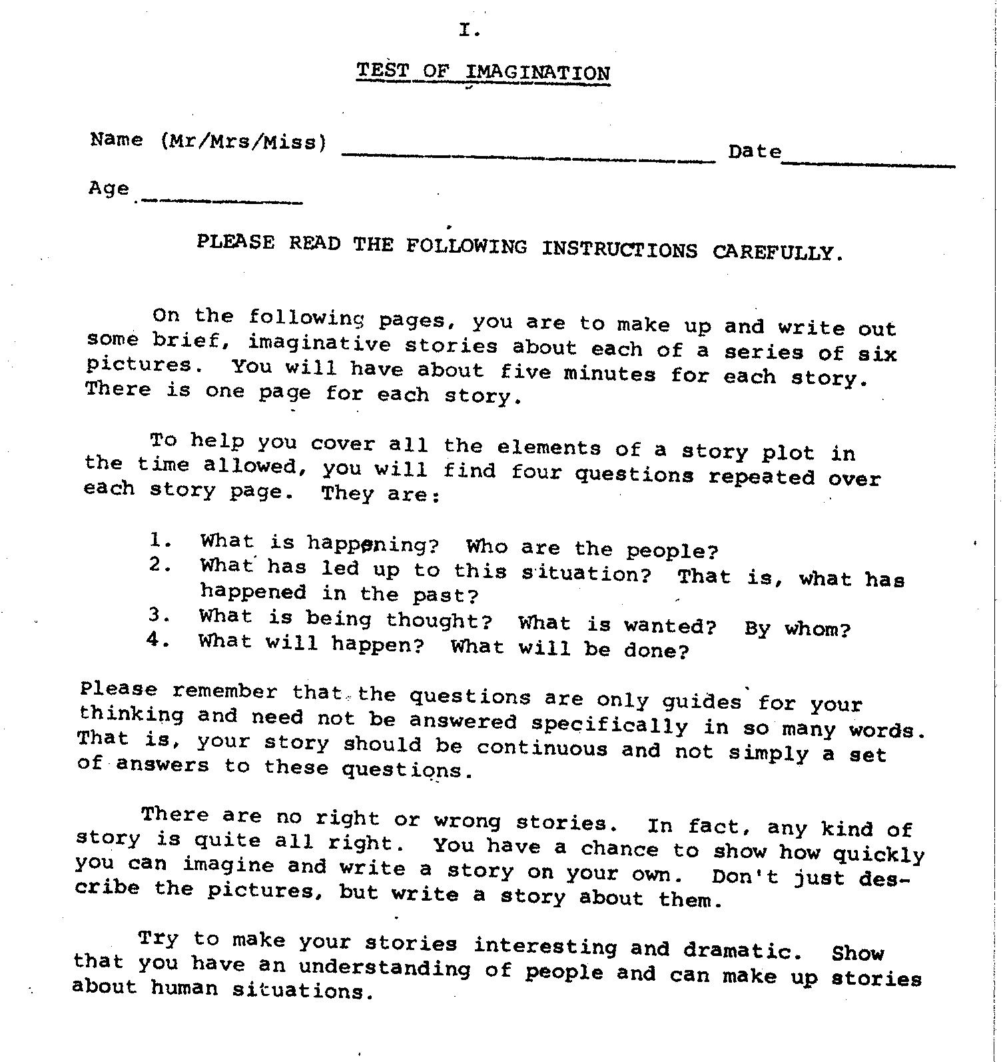

Slide 121
And here are the pictures

Slide 122
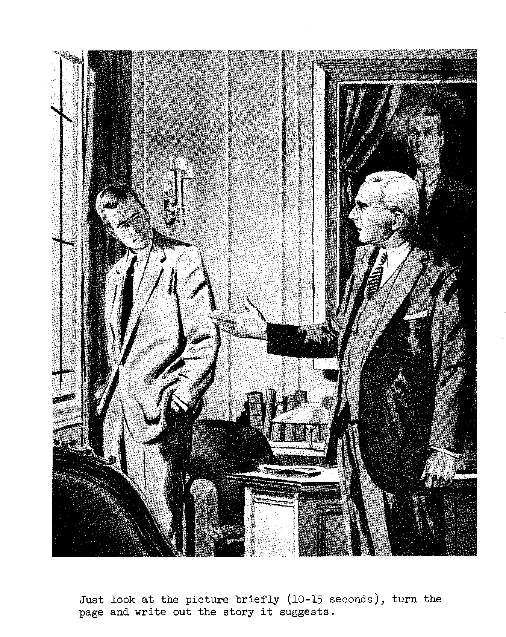

Slide 123
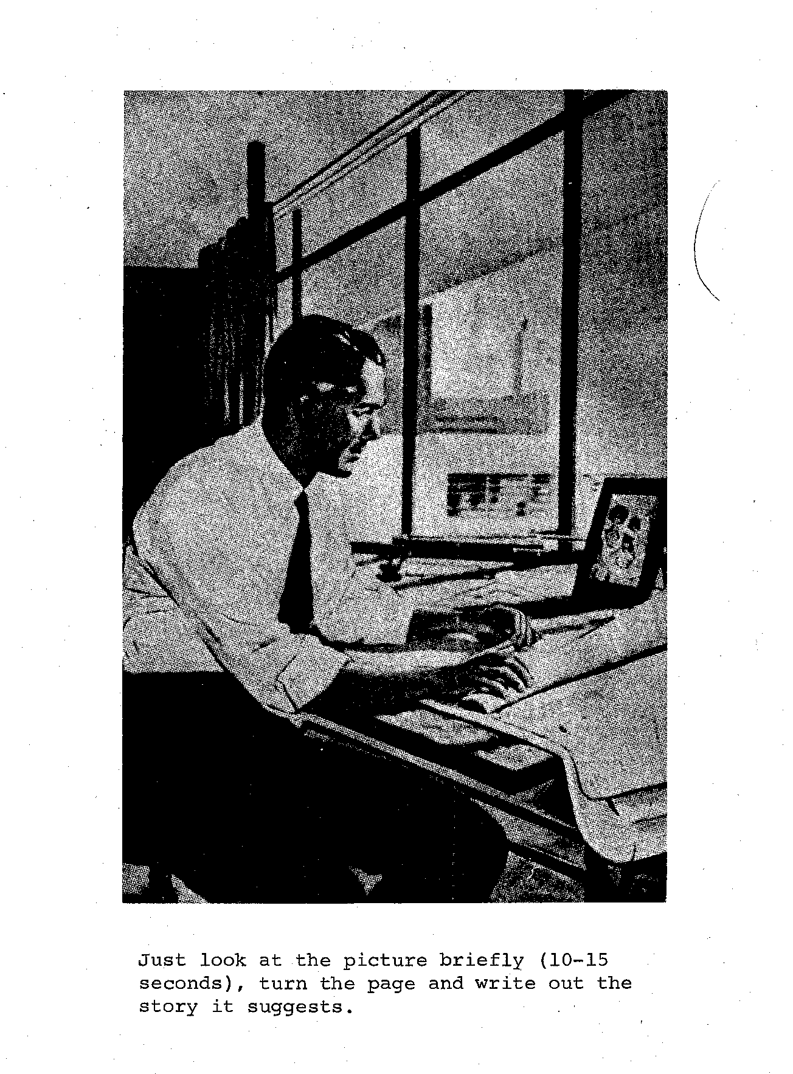

Slide 125
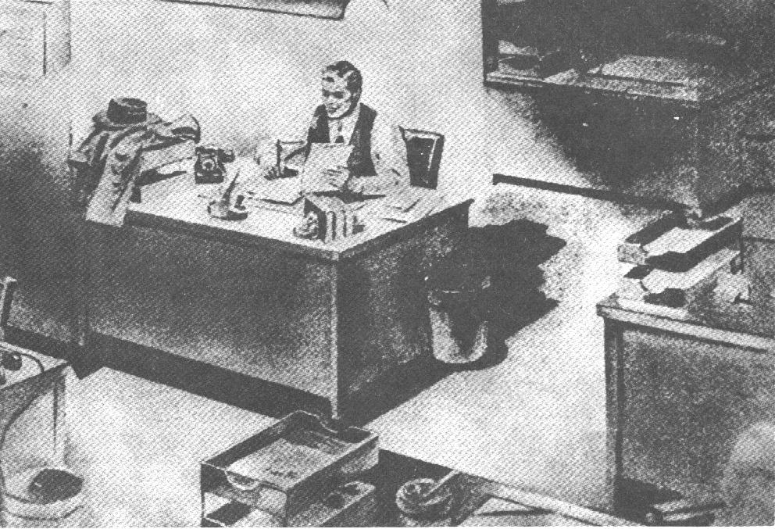

Slide 126
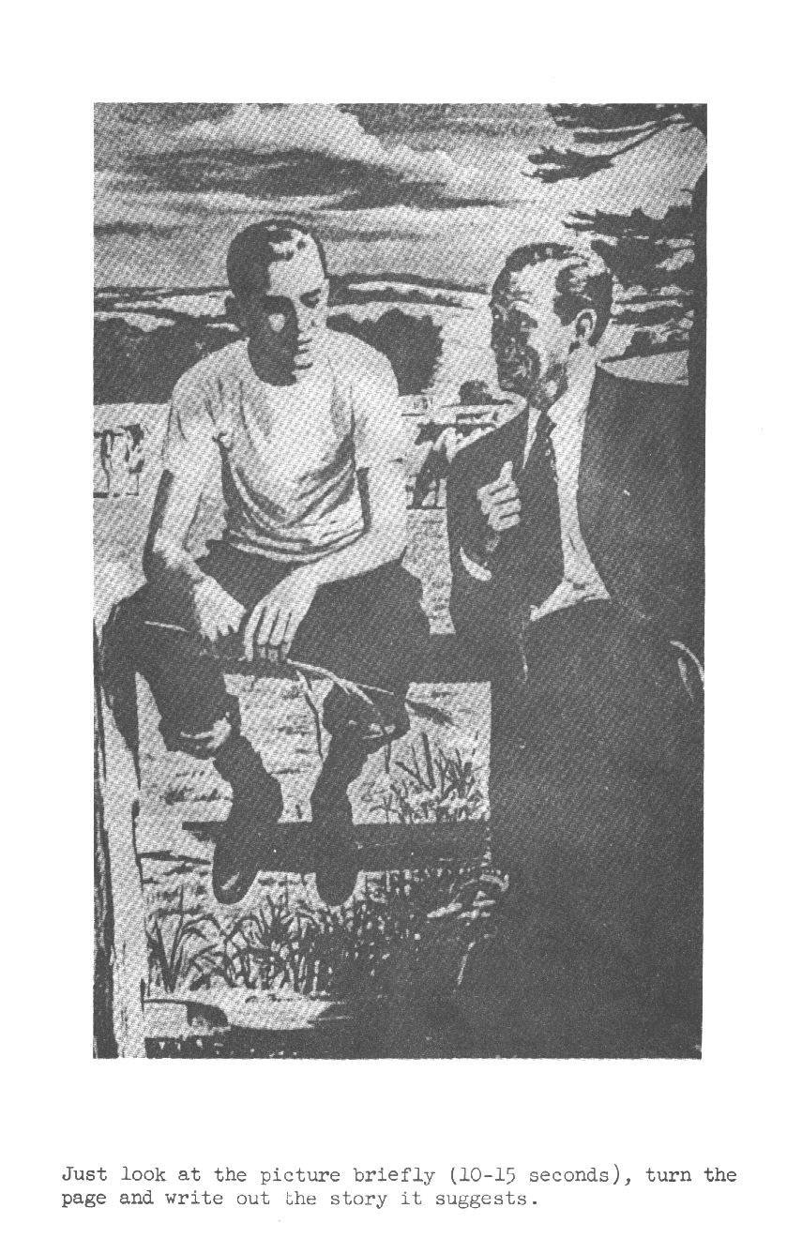

Slide 128
The scoring then proceeded as follows:

Slide 129
Ask yourself what kind of activity the person who wrote the story cares about and, in a sense, how much energy he or she sees his or her characters as putting into that kind of activity. (It is a somewhat circular process.)

Slide 130
In point of fact, for reasons which we do not go into here but which had something to do with discovering that they could not generate arousal conditions for most of Murray’s "personality” traits, they focussed the scorers’ attention on on three: Achievement, affiliation and power. (And they also demonstrated that these three scores had enormous impact on people’s lives and society.)

Slide 131
Here are some extracts from very brief scoring manuals they generated for training purposes. Ideally, I should flick back and forth between the pages of the manuals and the scoring grids that accompanied them.

Slide 132
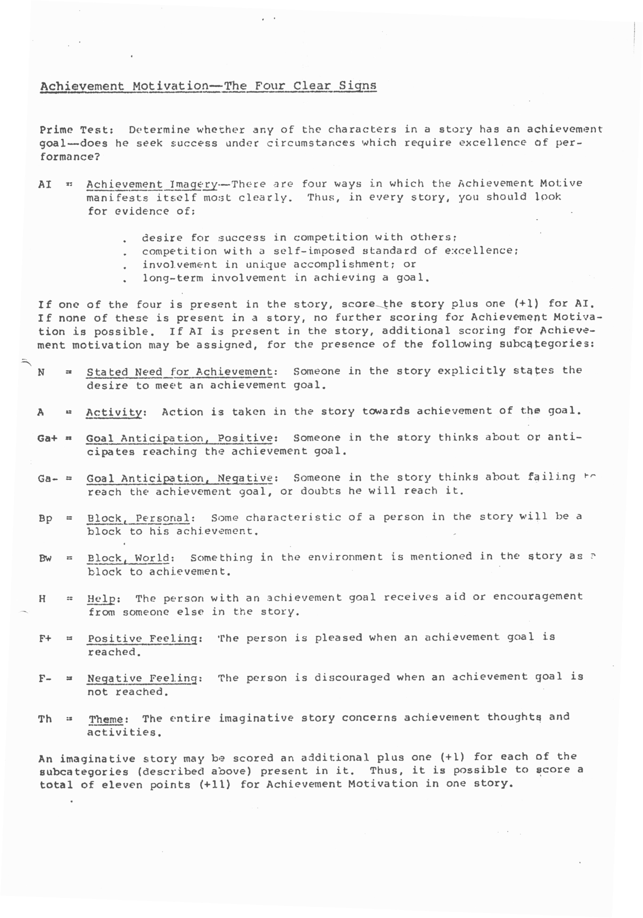

Slide 134
For each story one puts a tick (check mark) under the symbol for each reference in the grid below.

Slide 135
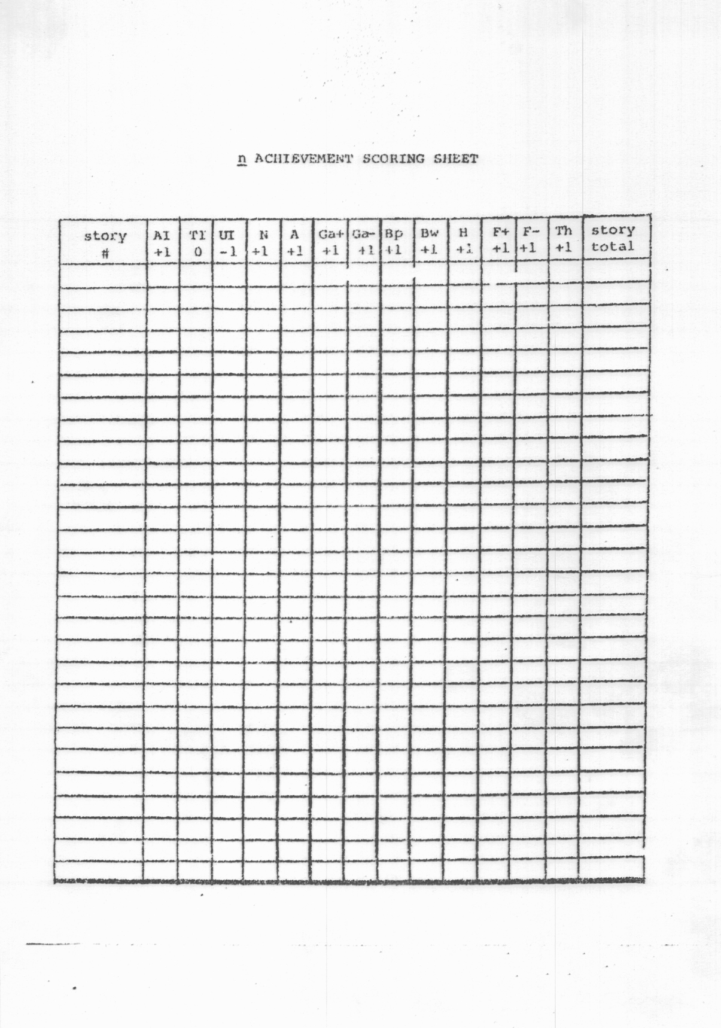

Slide 136
And then one adds the number of check marks in each line to give a total for that story, entering it in the left-hand column. And then sums the scores across stories to give a total score for n.Achievement.

Slide 137
And then one follows the same procedures for the affiliation and power motives as defined in the next two overheads to generate a 3-score profile for n.Ach., n.Aff., and n.Pow.

Slide 138
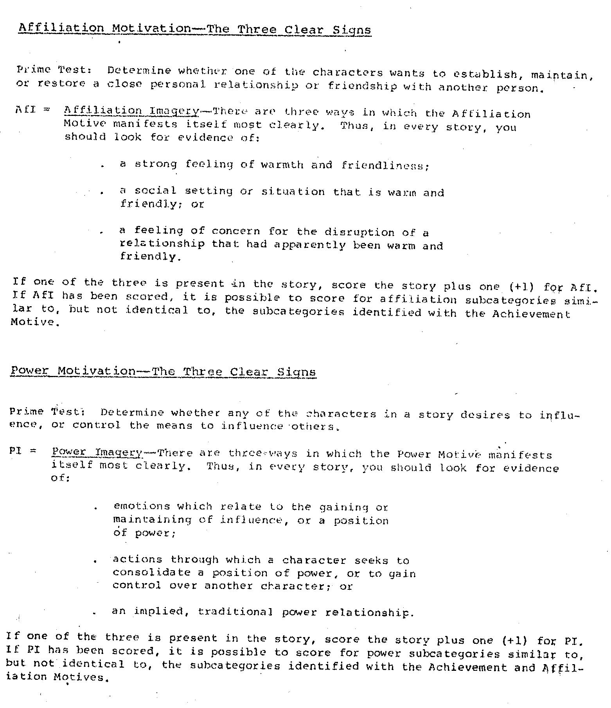

Slide 140
Note that the score obtained by summing across what we may now call components of competence to predict success at that kind of activity (n.Ach, n.Aff and n.Pow) does not look anything like an internally consistent factor score or a score derived from an IRT-based test.
In fact the whole process looks like the computation of a multiple regression coefficient designed to help predict success at each of these activities by summing across a number of maximally independent predictors.

Slide 141
No wonder this framework did not go down well with conventional psychometricians … most of whom never looked at the relevant material anyway.

Slide 142
Right. So. It seems that, if one wishes to index the kinds of competence we spoke about earlier what one needs to do is to extend number (and specificity) of motives to be assessed. And then to include more components of competence that are to be taken into account. So this is what we have been doing.

Slide 143
The scoring system can then be represented in the form of the grid shown on the next slide. In it, some of the activities which people might be strongly motivated to undertake are listed across the top. And some of the components of competence they might bring to bear to achieve them are shown down the side.

Slide 144
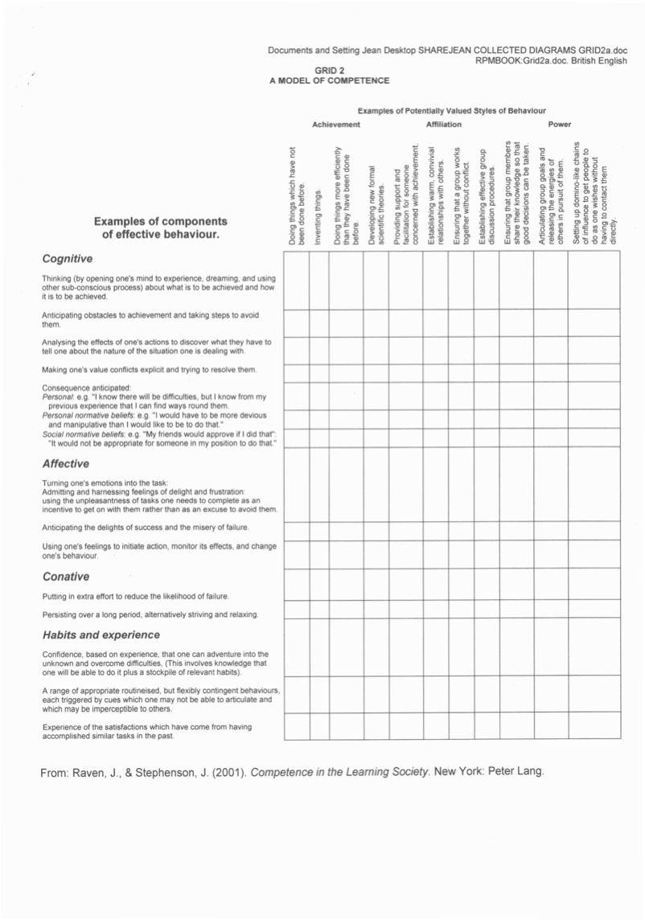

Slide 145
Total scores can then be calculated to predict success at each activity the individual is predisposed to undertake.

Slide 146
To maintain continuity, the potentially valued activities have been grouped under the generic headings of Achievement, Affiliation, and Power although it has been our experience that such dispositions are very specific: for example, people who are disposed to undertake one kind of achievement-oriented activity are not necessarily disposed to undertake other kinds of achievement-oriented activity.

Slide 147
The list of components of competence which may be brought to bear (ie the left hand list) has been extended in the next overhead, which runs over 3 slides.

Slide 151
As mentioned earlier, the number of specific thing people may be strongly motivated to do (ie the number of potential entries across the top of the grid) seems to us to be legion while the number of components of competence seems more limited.

Slide 152
In a sense, we used this framework, as it emerged, to guide the open-ended enquiries summarised earlier. It was a circular process. In the process we noticed that the generic titles across the top really do not work. For example, people who focus on one type of achievement are not necessarily attracted by other types of achievement activity.

Slide 153
And we noted things about the kinds of environment which facilitate people’s use of the environment to hone the components of competence they need to pursue them. But I will not pursue these things here.

Slide 154
But I would like to draw your attention to one more thing: all the motivational dispositions listed across the top end in “ing”.

Slide 155
The problem now is first to refine this list of possible motivational dispositions. Factor analysis is not going to help us because the dispositions are idiosyncratic.

Slide 156
What we need is something like Linnaeus’s framework for classifying species or the periodic table used to arrange chemical elements in a meaningful way.

Slide 157
And then we need to refine the list of components of competence down the side.

Slide 158
To illustrate the difficulty of moving forward I should tell you (ad. lib. only) what happened when Lyle Spencer set out to publish a book which would do this.

Slide 159
But perhaps Rene and his colleagues – or one of you – will take up the challenge.

Slide 160
Raven Seminar Prague Background material Version date: 13 January 2020 Atkinson J. W. (1958). (Ed.). Motives in Fantasy, Action and Society. New York: Van Nostrand. Bouchard, T.J. et al (1996) Genes, Drives, Environment, and Experience: EPD Theory Revised. Chapter 1 (pages 5 – 43) in Benbow, C.P. et al Intellectual Talent: Psychometric and Social Issues. Baltimore, John Hopkins Press. Eudora Attach: EPDTom Chap.pdf. Bouchard, T.J. (2015) Experience Producing Drive Theory: Personality “Writ Large”. Personality and Individual Differences 90 :302-314 DOI: 10.1016/j.paid.2015.11.007. https://sci-hub.si/10.1016/j.paid.2015.11.007 Flanagan, J. C. (1954). The critical incident technique. Psychological Bulletin, 51, 327-358. Harris, J. R. (2006). No Two Alike: Human Nature and Human Individuality. New York: W. W. Norton. Hayes, K.J.(1962) Genes, Drives, and Intellect. Psychological Reports 10 299-342. https://www.gwern.net/docs/iq/1962-hayes.pdf

Slide 161
Johnson, W. (2010). Extending and testing Tom Bouchard’s Experience Producing Drive Theory. Personality and Individual Differences. 49, 296-3011. https://sci-hub.si/10.1016/j.paid.2009.11.022 Kazdin, A. E. (2006). Arbitrary metrics: Implications for identifying evidence-based treatments. American Psychologist, 61, 42-49. https://psycnet.apa.org/record/2006-00920-004 McClelland, D. C., Atkinson, J. W., Clark, R. A., & Lowell, E. L. (1958). A scoring manual for the achievement motive; R. W. Heynes, J. Veroff, & J. W. Atkinson, A scoring manual for the affiliation motive; J. Veroff, A scoring manual for the power motive. Respectively, Chapters 12, 13 and 14 in J. W. Atkinson (Ed.), Motives in Fantasy, Action and Society. New York: Van Nostrand. McClelland, D. C. (1978). Guide to Behavioral Event Interviewing. Boston: McBer. Murray, H. A. (1938). Explorations in Personality. New York: OUP. McCrae, R.R. & Mottus, R. (2019) What Personality Scales Measure: A New Psychometrics and Its Implications for Theory and Assessment. Current Directions in Psychological Science, 28, 415–420. https://sci-hub.tw/10.1177/0963721419849559 Michael Pierce. A Critique of the Big Five https://www.youtube.com/watch?v=ohi6cOZ3dmU https://www.youtube.com/watch?v=4ixxDzuzFJ4 https://www.youtube.com/watch?v=3dgu0UPmaqQ Mõttus, R., & Rozgonjuk, D. (2019, December 2). Development Is in the Details: Age Differences in the Big Five Domains, Facets, and Nuances. Journal of Personality and Social Psychology. Advance online publication. http://dx.doi.org/10.1037/pspp0000276 (Eudora Attach: PreprintR.pdf; Mottus Rozgonjuk Age Differences …pdf). Mõttus, R., Sinick, J., Terracciano, A., Hřebíčková, M., Kandler, C., Ando, J., Mortensen, E. L., Colodro-Conde, L., & Jang, K. L. (2018). Personality Characteristics Below Facets: A Replication and Meta-Analysis of Cross-Rater Agreement, Rank-Order Stability, Heritability, and Utility of Personality Nuances. Journal of Personality and Social Psychology. http://dx.doi.org/10.1037/pspp0000202 https://sci-hub.si/10.2307/1129703

Slide 162
Plomin, R. (2018). Blueprint: How DNA Makes Us Who We Are. London, UK: Allen Lane.
Raven, J. (1980). Parents, Teachers and Children: An Evaluation of an Educational Home Visiting Programme. Edinburgh: Scottish Council for Research in Education.
Raven, J. (1994). Managing Education for Effective Schooling: The Most Important Problem Is to Come to Terms with Values. Unionville, New York: Trillium Press. www.rfwp.com; Edinburgh, Scotland: Competency Motivation Project, 30, Great King Street, Edinburgh EH3 6QH. http://eyeonsociety.co.uk/resources/fulllist.html#managing_education
Raven, J. (1997). Competence in Modern Society: Its Identification, Development and Release. Unionville, New York: Royal Fireworks Press. www.rfwp.com (First published in 1984 in London, England, by H. K. Lewis.)
Raven, J. (2014). Our incompetent society (with a discussion of some of the competencies needed to transform it). http://eyeonsociety.co.uk/resources/Incompetent-society-v3.pdf Russian translation by Oleg Yarygin: Part I: Baltic Humanitarian Journal (2016) T.5. 4(17) 274-292. http://www.napravo.ru/pages/nauchnye_jurnaly/baltiiskii_gumanitarnyi_jurnal/nauchnye_jurnaly_/ Part II: Azimuth Of Scientific Researches / Pedagogy and Psychology, (2016) T.5, 4(17) 198-205. http://www.napravo.ru/pages/nauchnye_jurnaly/jurnal_vektor_nauki/nomera_jurnala_2013/
Raven, J., Johnstone, J., & Varley, T. (1985). Opening the Primary Classroom. Edinburgh: Scottish Council for Research in Education. http://eyeonsociety.co.uk/resources/OTPC-complete.pdf
Raven, J., & Stephenson, J. (Eds.). (2001). Competence in the Learning Society. New York: Peter Lang. Many chapters also available at http://eyeonsociety.co.uk/resources/fulllist.html#competence_in_the_learning_society
Scarr, S. (1996). How people make their own environments: Implications for parents and policy makers. Psychology, Public Policy, and Law, 2(2), 204-228. https://sci-hub.si/https://www.jstor.org/stable/1129703
Scarr, S., & McCartney, K. (1983). How people make their own environments: A Theory of genotype - environment effects Child Development, 54, 424-435. https://sci-hub.si/https://www.jstor.org/stable/1129703

Slide 164
non rpm conference papers: mottus prague reading list. docx.
Raven Seminar Prague
Background material
Version date: 13 January 2020
Atkinson J. W. (1958). (Ed.). Motives in Fantasy, Action and Society. New York: Van Nostrand.
Bouchard, T.J. et al (1996) Genes, Drives, Environment, and Experience: EPD Theory Revised. Chapter 1 (pages 5 – 43) in Benbow, C.P. et al Intellectual Talent: Psychometric and Social Issues. Baltimore, John Hopkins Press. Eudora Attach: EPDTom Chap.pdf.
Bouchard, T.J. (2015) Experience Producing Drive Theory: Personality “Writ Large”. Personality and Individual Differences 90 :302-314 DOI: 10.1016/j.paid.2015.11.007. https://sci-hub.si/10.1016/j.paid.2015.11.007
Flanagan, J. C. (1954). The critical incident technique. Psychological Bulletin, 51, 327-358.
Harris, J. R. (2006). No Two Alike: Human Nature and Human Individuality. New York: W. W. Norton.
Hayes, K.J.(1962) Genes, Drives, and Intellect. Psychological Reports 10 299-342. https://www.gwern.net/docs/iq/1962-hayes.pdf
Johnson, W. (2010). Extending and testing Tom Bouchard’s Experience Producing Drive Theory. Personality and Individual Differences. 49, 296-3011. https://sci-hub.si/10.1016/j.paid.2009.11.022
Kazdin, A. E. (2006). Arbitrary metrics: Implications for identifying evidence-based treatments. American Psychologist, 61, 42-49. https://psycnet.apa.org/record/2006-00920-004
McClelland, D. C., Atkinson, J. W., Clark, R. A., & Lowell, E. L. (1958). A scoring manual for the achievement motive; R. W. Heynes, J. Veroff, & J. W. Atkinson, A scoring manual for the affiliation motive; J. Veroff, A scoring manual for the power motive. Respectively, Chapters 12, 13 and 14 in J. W. Atkinson (Ed.), Motives in Fantasy, Action and Society. New York: Van Nostrand.
McClelland, D. C. (1978). Guide to Behavioral Event Interviewing. Boston: McBer.
Murray, H. A. (1938). Explorations in Personality. New York: OUP.
McCrae, R.R. & Mottus, R. (2019) What Personality Scales Measure: A New Psychometrics and Its Implications for Theory and Assessment. Current Directions in Psychological Science, 28, 415–420. https://sci-hub.tw/10.1177/0963721419849559

Slide 165
I use the word competencies to refer to emotional predispositions to engage in fairly specific, but complex, activities having cognitive, affective, and conative components in effective ways in a variety of situations. As such, they involve much more than cognitive knowledge and mental or sensory-motor skills. Even the requisite “knowledge” is largely tacit, consisting of knowledge (often of ways of doing things) located in people’s hearts and hands – such as emotionally-based predispositions to react to non-verbal feedback from motor activities and other people’s body language. The crucial thing is that components of this feedback are sub-consciously selected and intensively engaged to produce effective action, mental or physical.

